Slide 1
DICE Design
13.06
Notes:
Cheri’s feedback:
Page 2 – let’s make retention just like the others – discovery then the recommendations on a separate page
Page 3 – Should be upgrade inquiry instead of Update. For Retention they would need both BTN and CTN
Page 4 – Do we need this page or could we go straight into the next page with the customer information prepopulated? Or is it better to make sure the customer is correct before we move on. If so – I don’t want the rep to have to pick any of the drop downs. The text could be Thank you for being an AT&T Digital Life customer.
Page 5 – nothing bau
Page 6 – We don’t allow downgrades – so I don’t want to show then that. We do want to show the final MRC. Can we make what they have existing a different color?
Page 7 – Can we make the text different colors for existing
Page 9 – I need to make the dispositions different for both retention and upgrade that what we have. We will need some scripting.

Slide 2
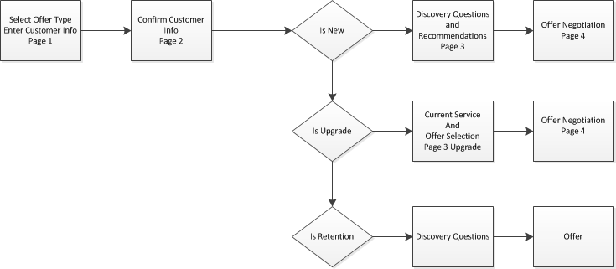
Page Flow
Notes:
Question: Do we need another page for Retention?
Answer: 2 pages

Slide 3
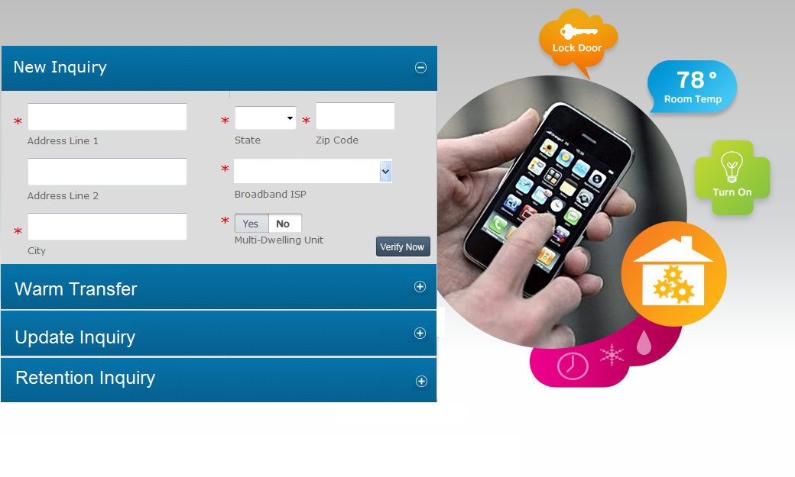
Notes:
Need Fields for each tab and confirm Tab Names
Warm transfer
Contact TN
Email Address
Upgrade Inquiry
BTN
CTN

Slide 4
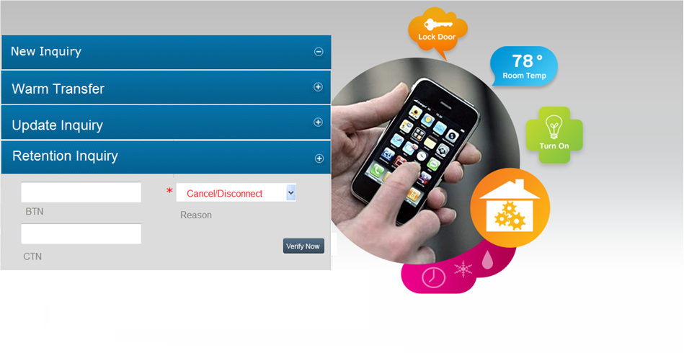
Notes:
Retention
Cancel
Disconnect
BTN
CTN

Slide 5
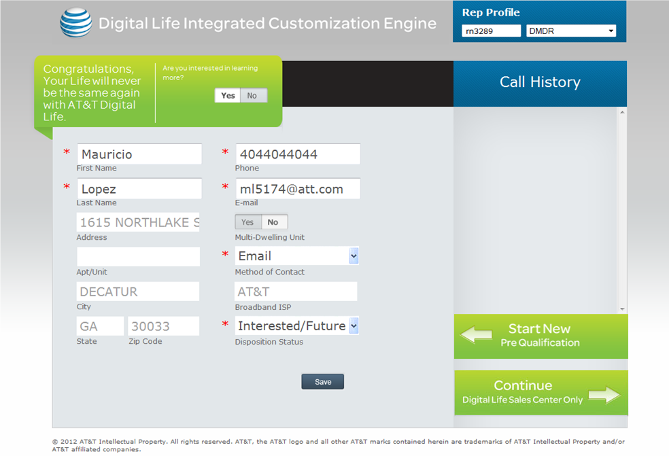
Notes:
Do we always have customer info confirmation? Retention?
No Skip for Upgrade and Retention
Answer: Can Skip for Upgrade and Retention. Customer information can be viewed on the next page?
Content for Green Sections?
Fields for Upgrade and Retention?

Slide 6
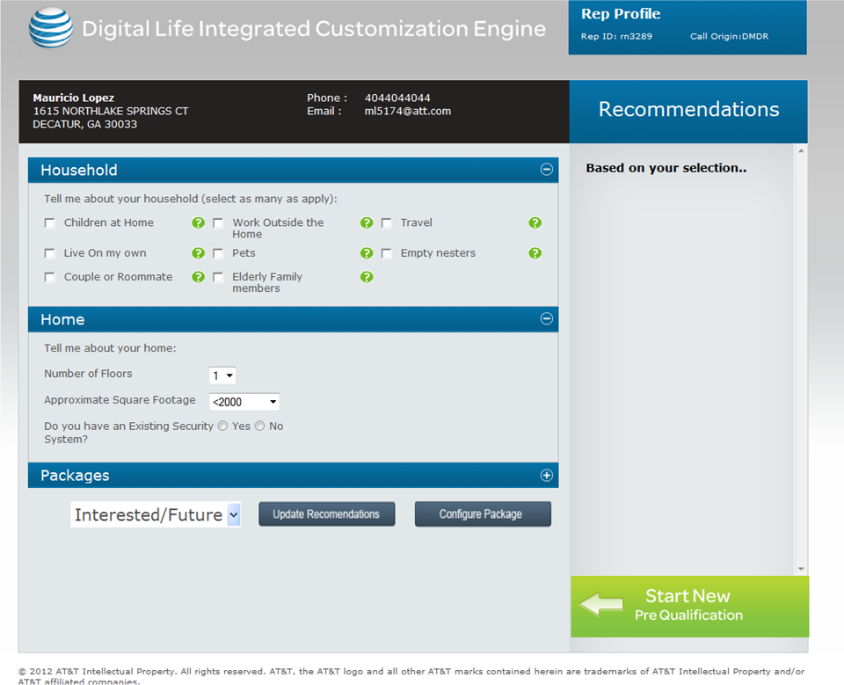
Notes:
Existing New Order Q&A and Recommendations

Slide 7
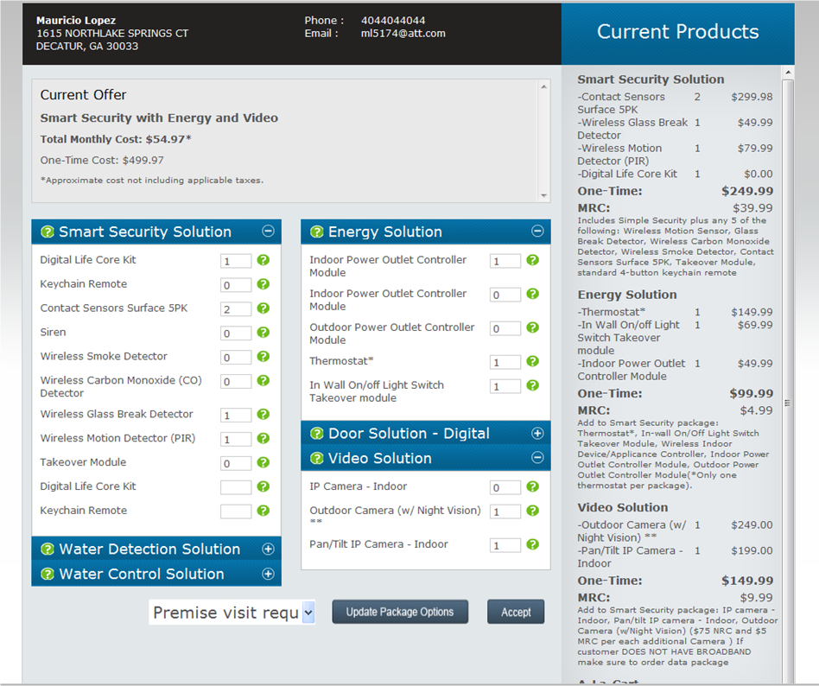
Notes:
Offer Negotiation Common for New and Upgrade.
Need to confirm presentation of add and removal of packages .
Negative MRC when removing a package
Color (Red for removal?)
Color for existing
Do we show final MRC what do we share with web view?

Slide 8
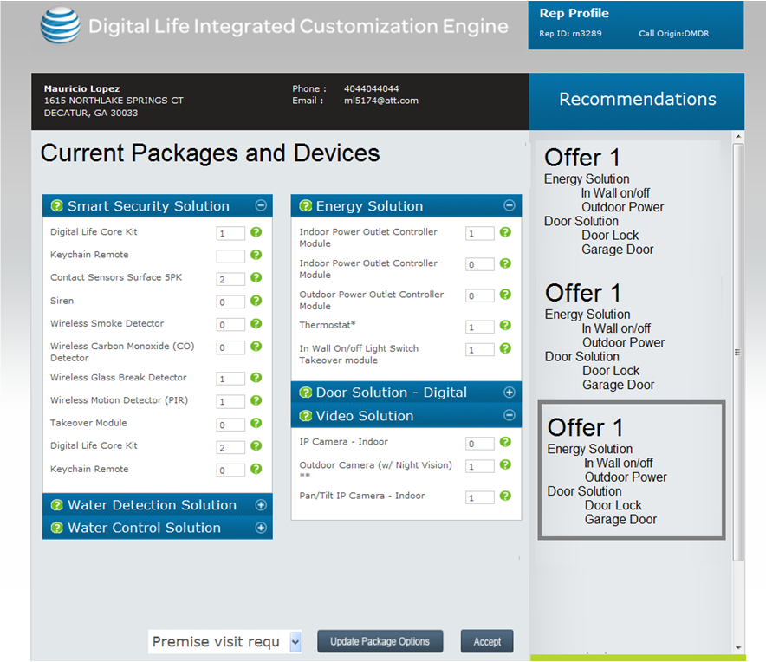
Notes:
Upgrade Current Services and initial offer selection

Slide 10
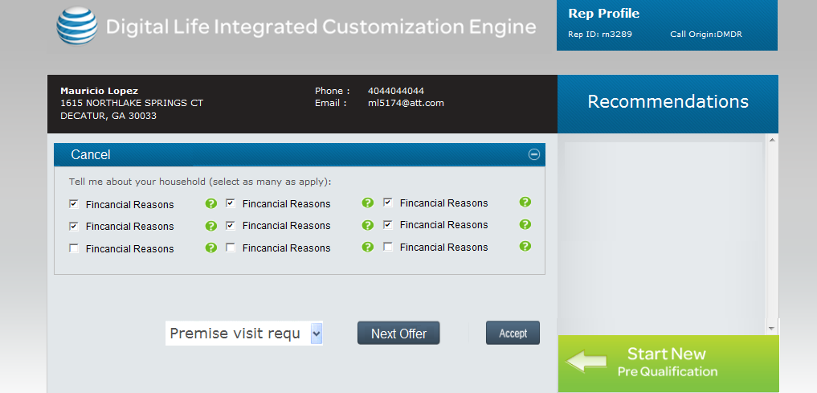

Slide 11
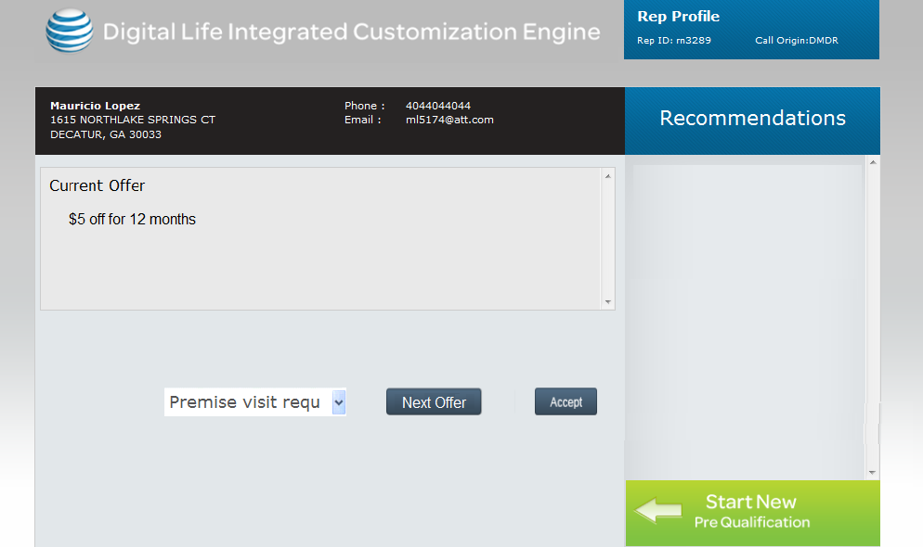

Slide 12
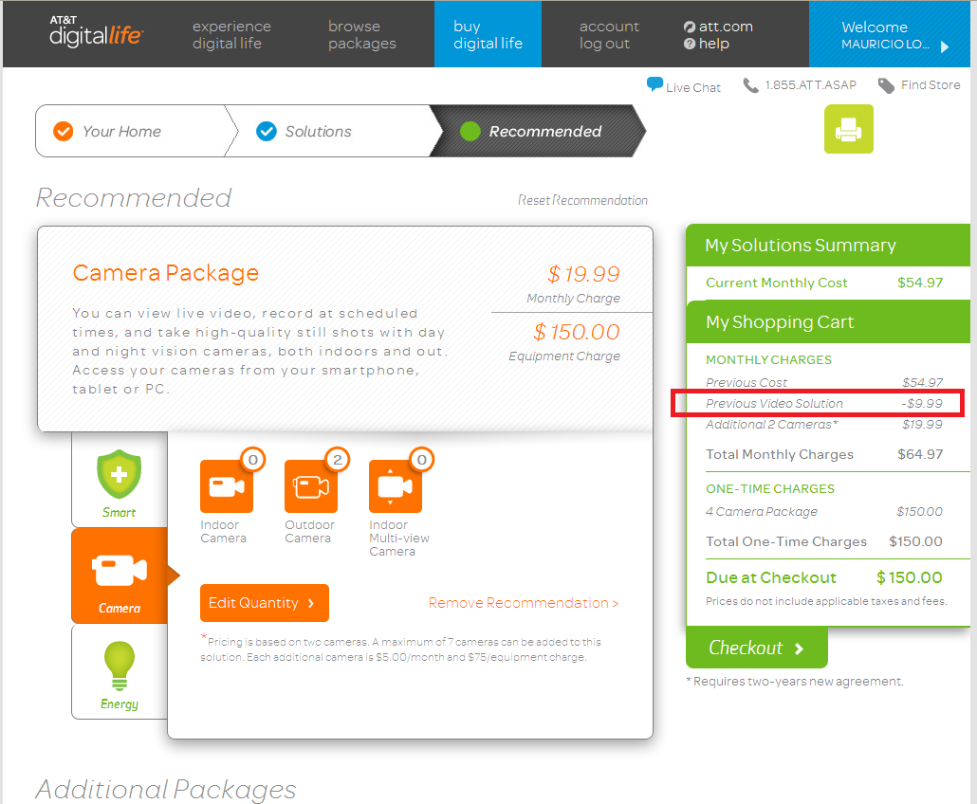
Notes:
Scrolling view of Offers on the Top
Cancel or Disconnect questions depending on selection on the first page
Any text for offers on the right? Script?
Buttons at the bottom to go to Next Offer and Set Disposition

